Slide 1
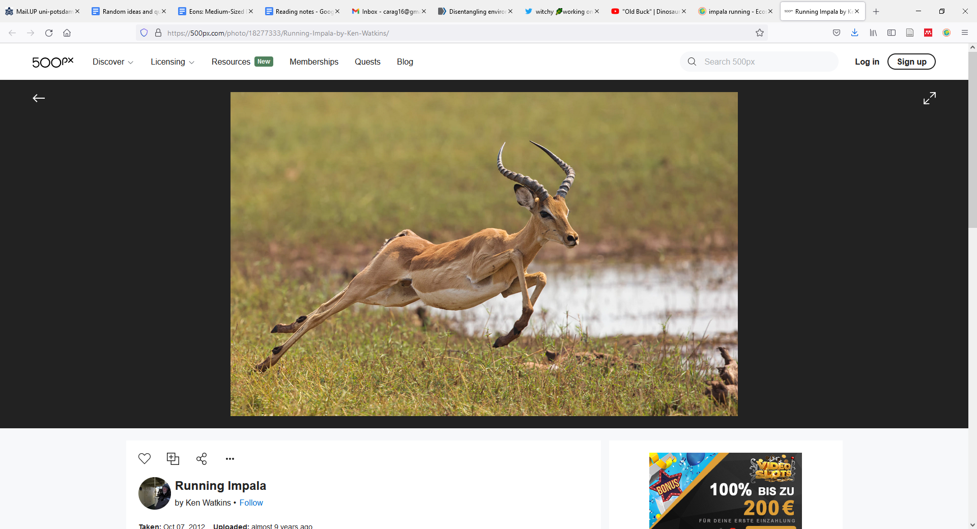
From individual energetics to biodiversity patterns
Ken Watkins
iStock

Slide 2
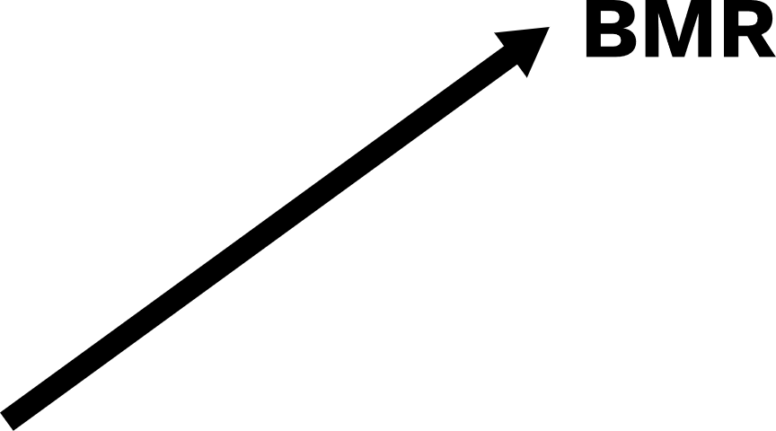




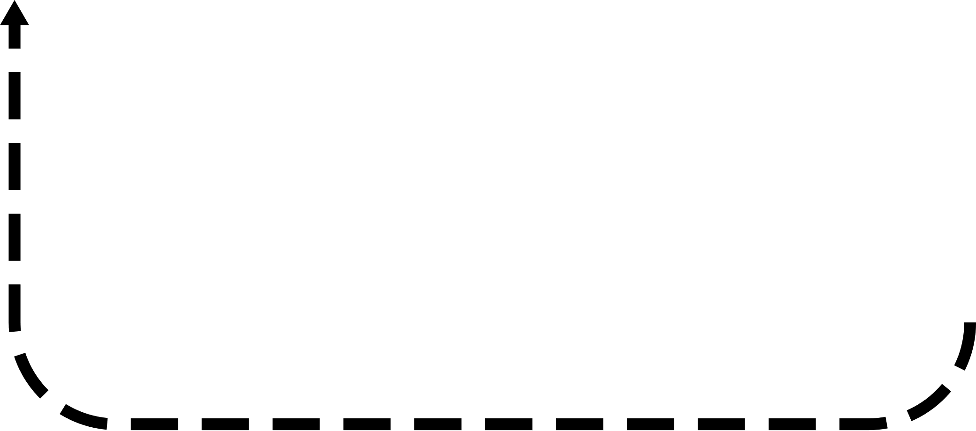

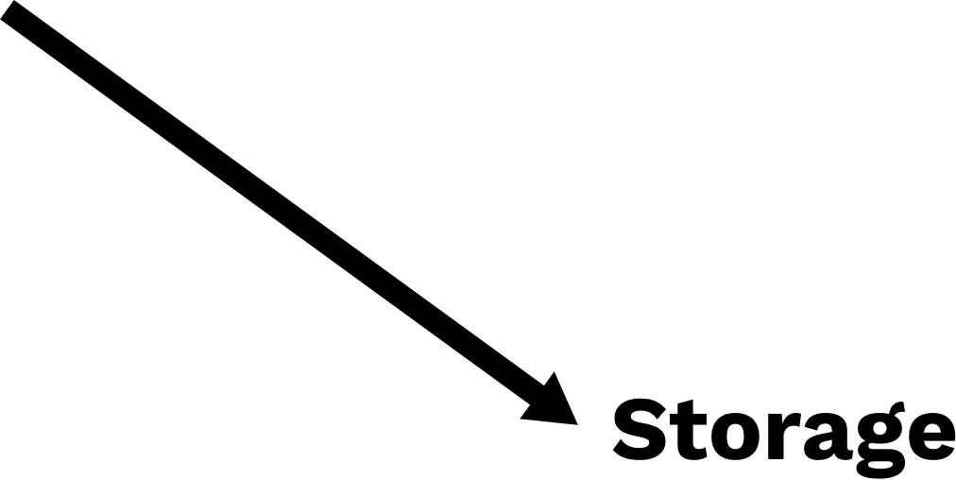


Slide 3
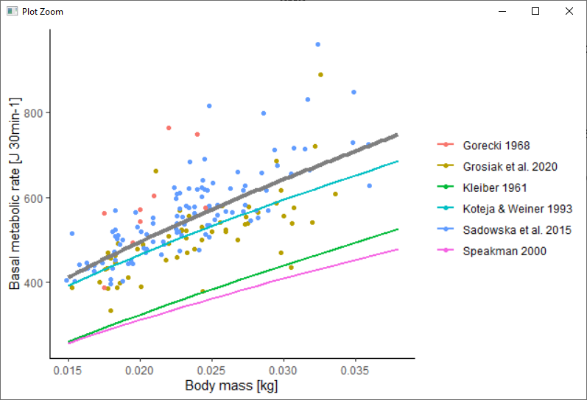
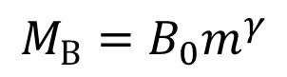
$${M_{B}=B}_{0}m^{γ}$$
Kleiber 1975; Sibly et al. 2013
Calibrated using data from Sadowska et al. 2015, Grosiak et al. 2020, & Górecki 1968

Slide 4
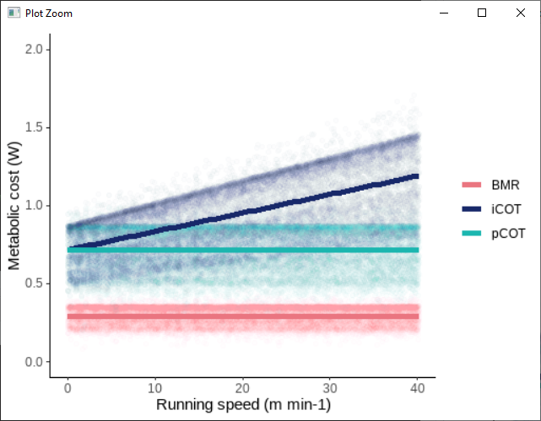
$$M_{L}=\left(B_{pcot}m^{γ_{pcot}}+ B_{icot}m^{γ_{icot}}×m×v\right)$$

Slide 5
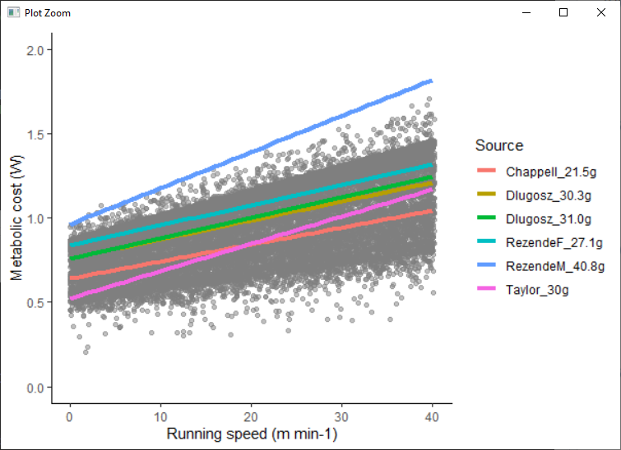
$$M_{L}=\left(B_{pcot}m^{γ_{pcot}}+ B_{icot}m^{γ_{icot}}×m×v\right)$$

Slide 6
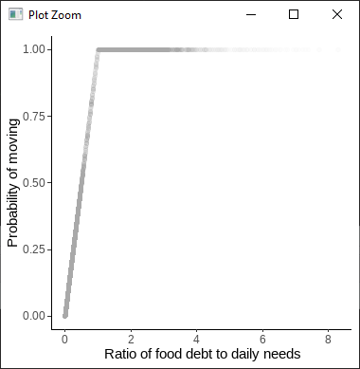
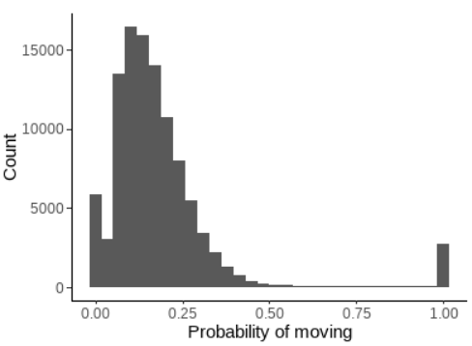
$$M_{L}=\left(B_{pcot}m^{γ_{pcot}}+ B_{icot}m^{γ_{icot}}×m×v\right)$$
Link between energy balance and activity
18.5 +- 17.1%

Slide 7
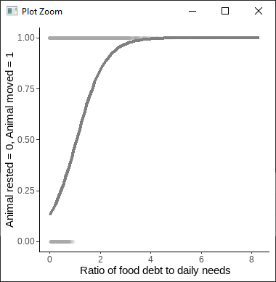
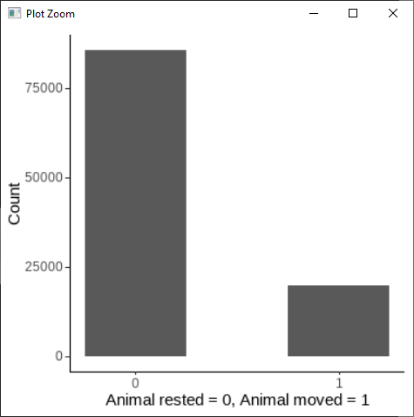
$$M_{L}=\left(B_{pcot}m^{γ_{pcot}}+ B_{icot}m^{γ_{icot}}×m×v\right)$$
Link between energy balance and activity
18.7 +- 39.0%

Slide 8
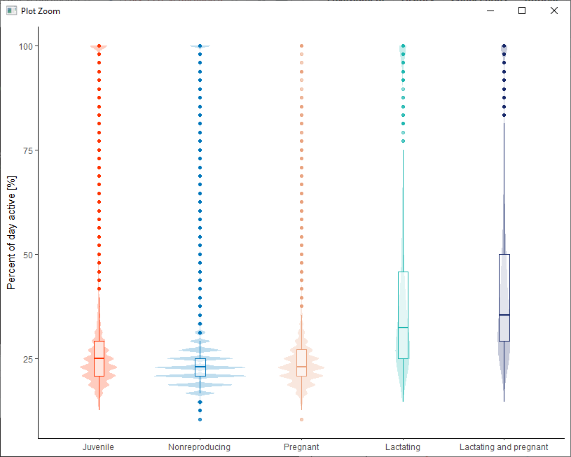
$$M_{L}=\left(B_{pcot}m^{γ_{pcot}}+ B_{icot}m^{γ_{icot}}×m×v\right)$$
Link between energy balance and activity

Slide 9
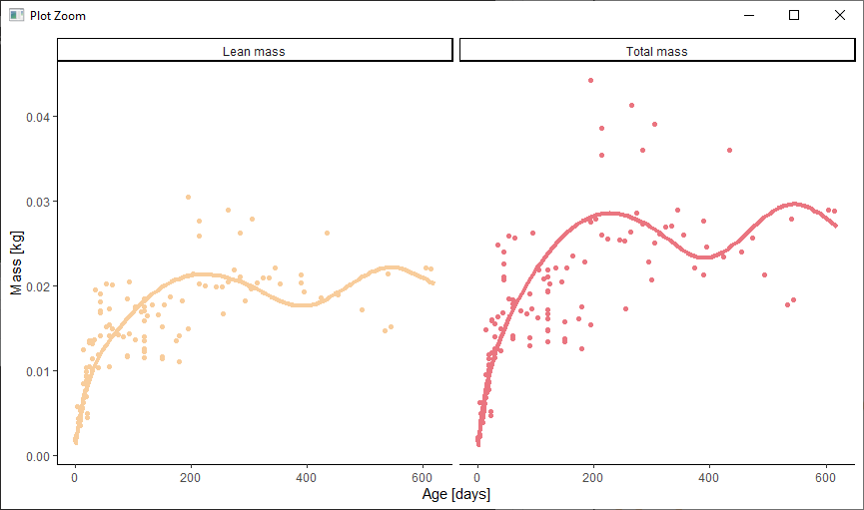
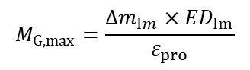
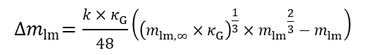
Change in mass:
$${∆m}_{lm}=\frac{k×κ_{G}}{48}\left({\left(m_{lm,∞}×κ_{G}\right)}^{\frac{1}{3}}×{m_{lm}}^{\frac{2}{3}}−m_{lm}\right)$$
Growth cost:
$$M_{G,max}=\frac{{∆m}_{lm}×{ED}_{lm}}{ε_{pro}}$$

Slide 10
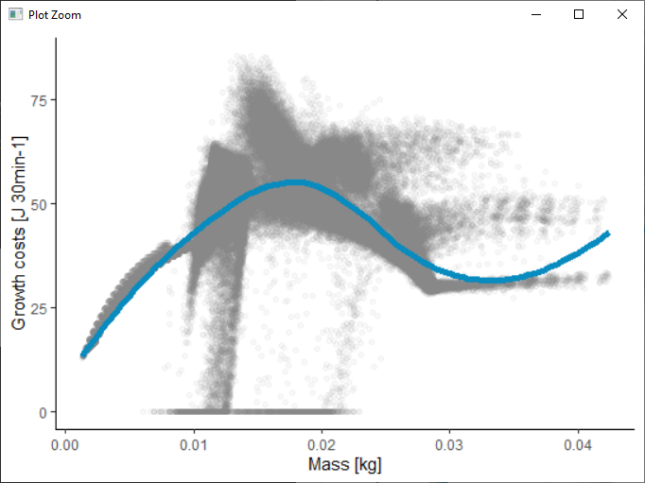
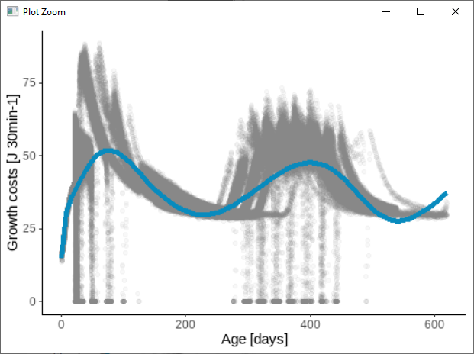
Change in mass:
$${∆m}_{lm}=\frac{k×κ_{G}}{48}\left({\left(m_{lm,∞}×κ_{G}\right)}^{\frac{1}{3}}×{m_{lm}}^{\frac{2}{3}}−m_{lm}\right)$$
Growth cost:
$$M_{G,max}=\frac{{∆m}_{lm}×{ED}_{lm}}{ε_{pro}}$$

Slide 11
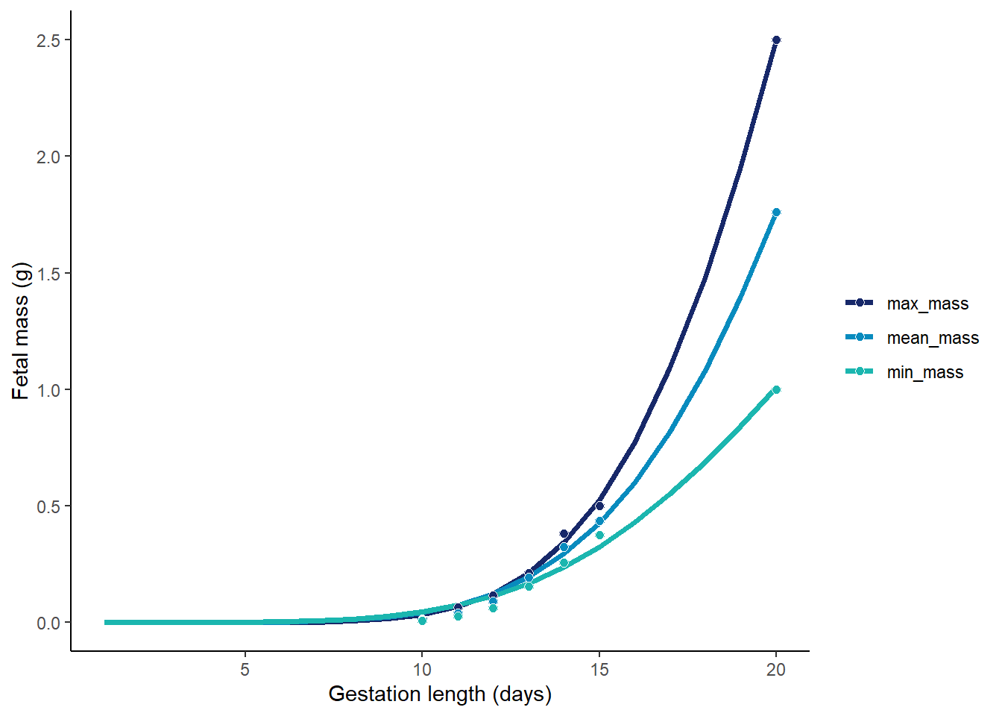
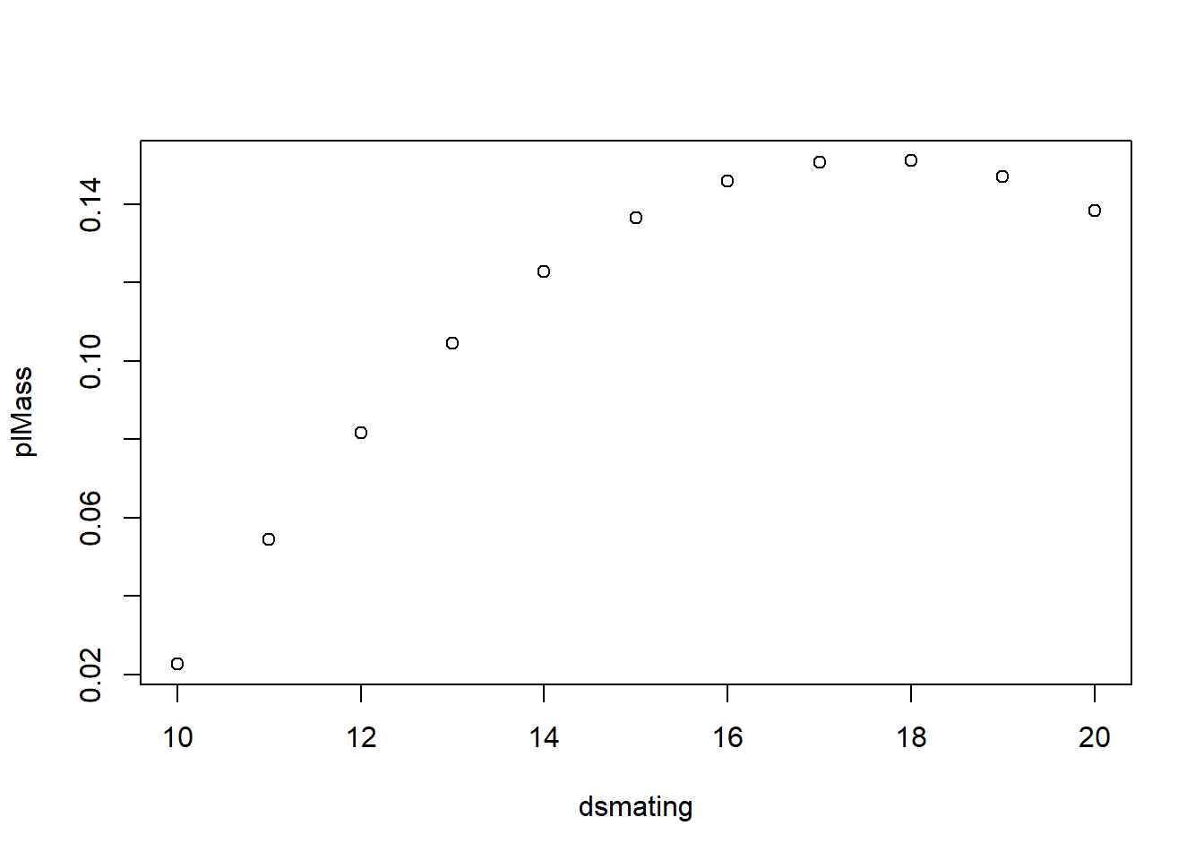
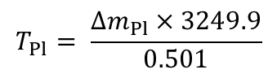

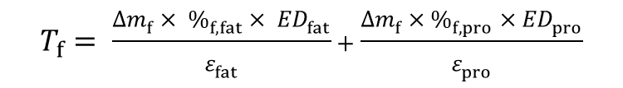
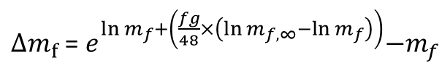
Pregnancy
$$M_{P}=\sum_{i=off \#}^{n_{off}}{\left({T_{f}}_{i}+{T_{Pl}}_{i}\right)}$$
$∆m_{f}$ =${ e}^{ln m_{f}+\left(\frac{fg}{48}×\left(\ln{m_{f,∞}}−ln m_{f}\right)\right)}−m_{f}$
$$T_{f}= \frac{∆m_{f}× \%_{f,fat}× {ED}_{fat}}{ε_{fat}}+\frac{∆m_{f}×\%_{f,pro}×{ED}_{pro}}{ε_{pro}}$$
Fetal mass
Ożdżeński and Mystkowska 1976
-Bank voles
Placental mass
Mu et al. 2008
- Lab mice
$$∆m_{Pl}=\left(−0.54180+0.07887×{age}_{gest}−0.002243×{{age}_{gest}}^{2}\right)−m_{p}$$
$$T_{Pl}= \frac{∆m_{Pl}×3249.9}{0.501}$$

Slide 12
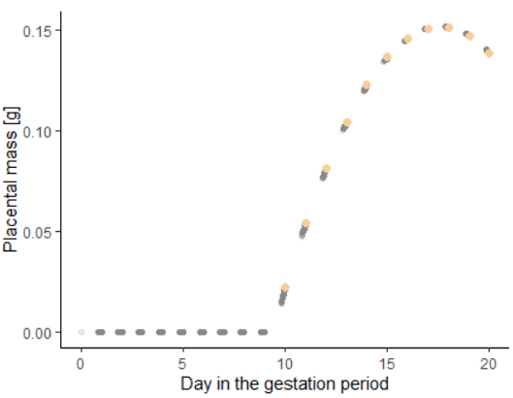
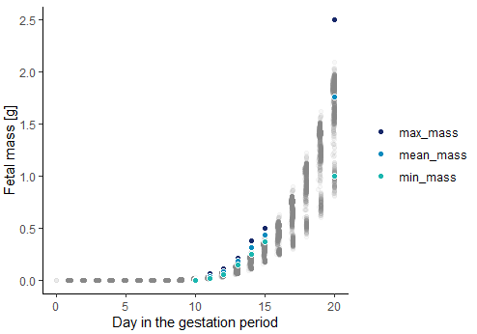
Pregnancy
$$M_{P}=\sum_{i=off \#}^{n_{off}}{\left({T_{f}}_{i}+{T_{Pl}}_{i}\right)}$$

Slide 13
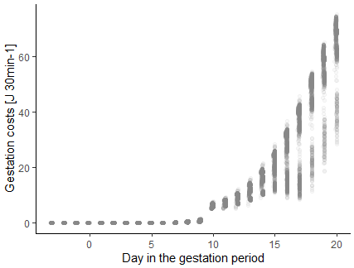
Pregnancy
$$M_{P}=\sum_{i=off \#}^{n_{off}}{\left({T_{f}}_{i}+{T_{Pl}}_{i}\right)}$$

Slide 14
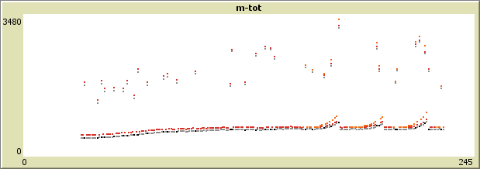
Pregnancy
$$M_{P}=\sum_{i=off \#}^{n_{off}}{\left({T_{f}}_{i}+{T_{Pl}}_{i}\right)}$$
Also increased BMR for females due to increased mass
– as in Trebatická et al. 2007

Slide 15
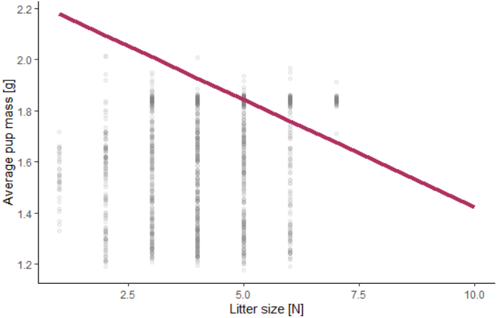
Pregnancy
From Mappes & Koskela 2004

Slide 16
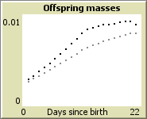
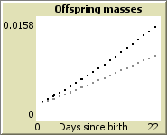
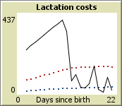
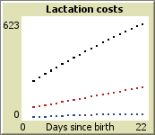

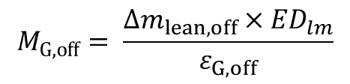
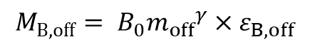
Lactation
$${M_{B,off}= B}_{0}{m_{off}}^{γ}×ε_{B,off}$$
$$M_{G,off}= \frac{∆m_{lean,off}×{ED}_{lm}}{ε_{G,off}}$$
$$M_{Lact}= \frac{\sum_{i=off \#}^{n_{off}}{{M_{B,off}}_{i}+{M_{G,off}}_{i}}}{ε_{mp}}$$
Total mass
Any extra goes to fat storage
Lean mass
Maximum
Total costs
Offspring BMR
Offspring growth

Slide 17
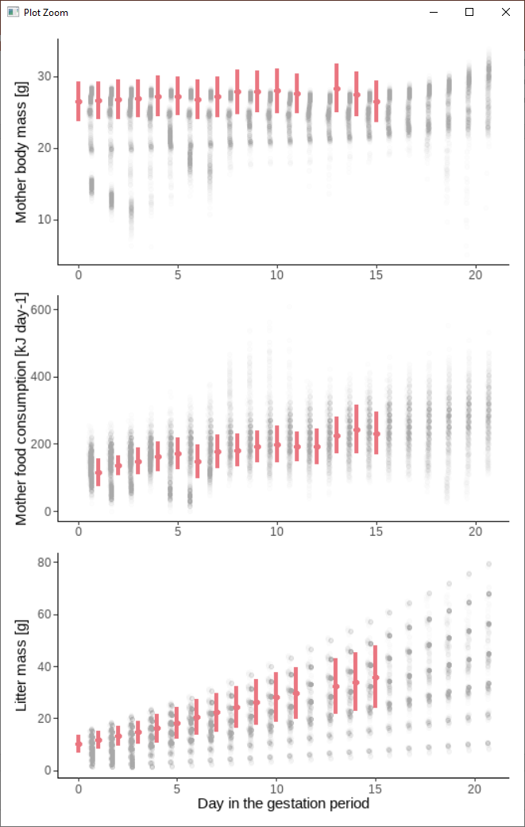
Lactation
From Sadowska et al. 2015
- for unshaved control mothers

Slide 18
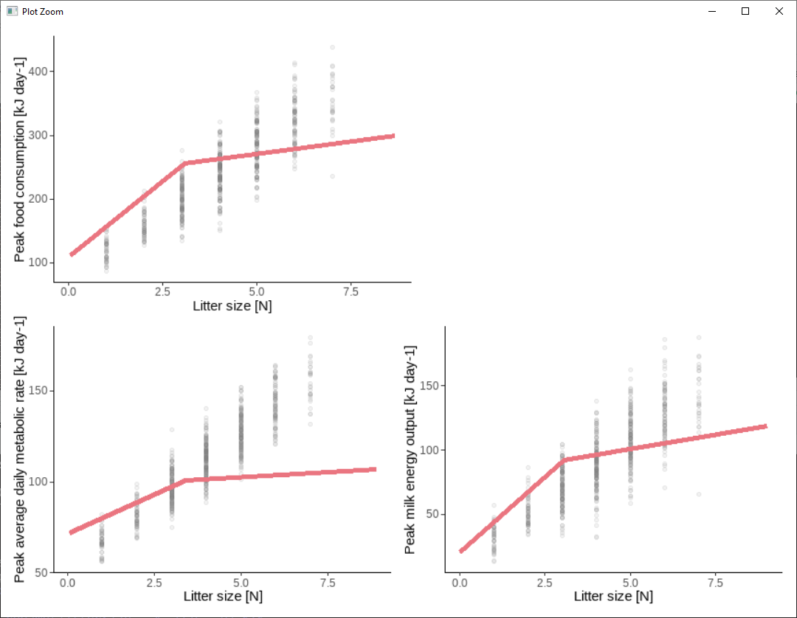
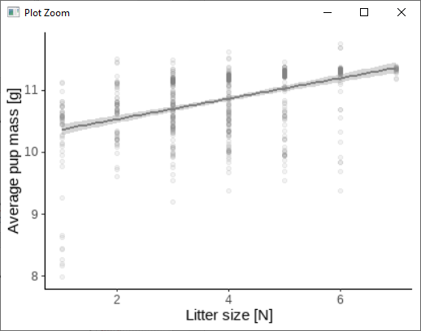
Lactation

Slide 19
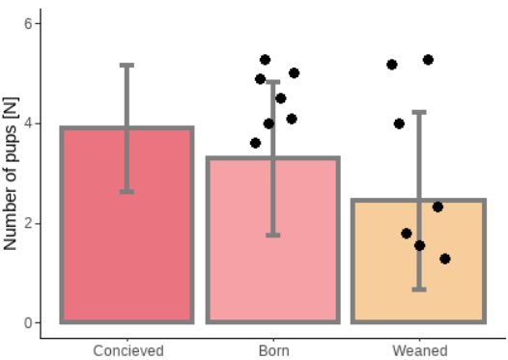
Lactation
Survival modelled as a modified version of adult survival (using separate constants for embryos and offspring)

Slide 20
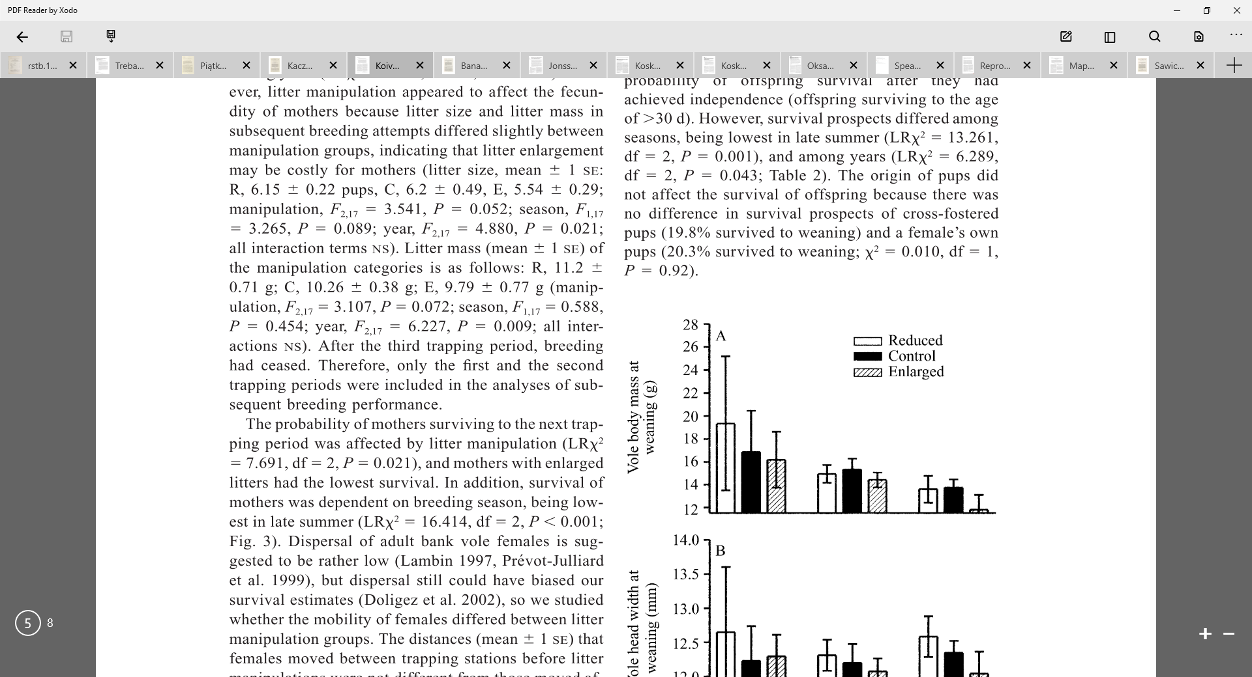
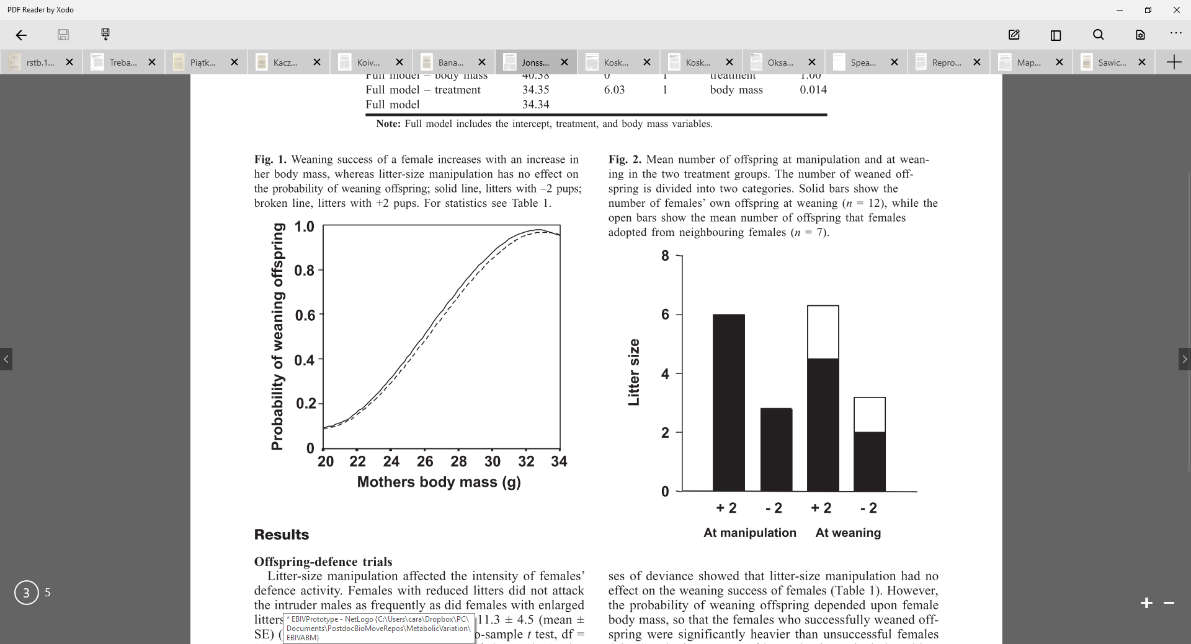
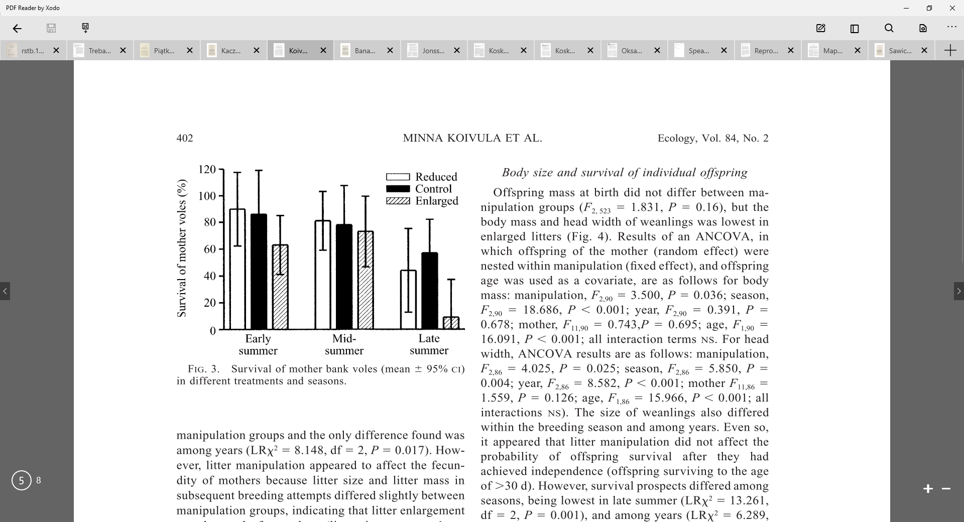
Lactation
Other useful patterns
Koivula et al. 2003
Johnson et al. 2002
Koskela 1998, Oksanen et al. 2001, Mappes et al. 1995

Slide 21
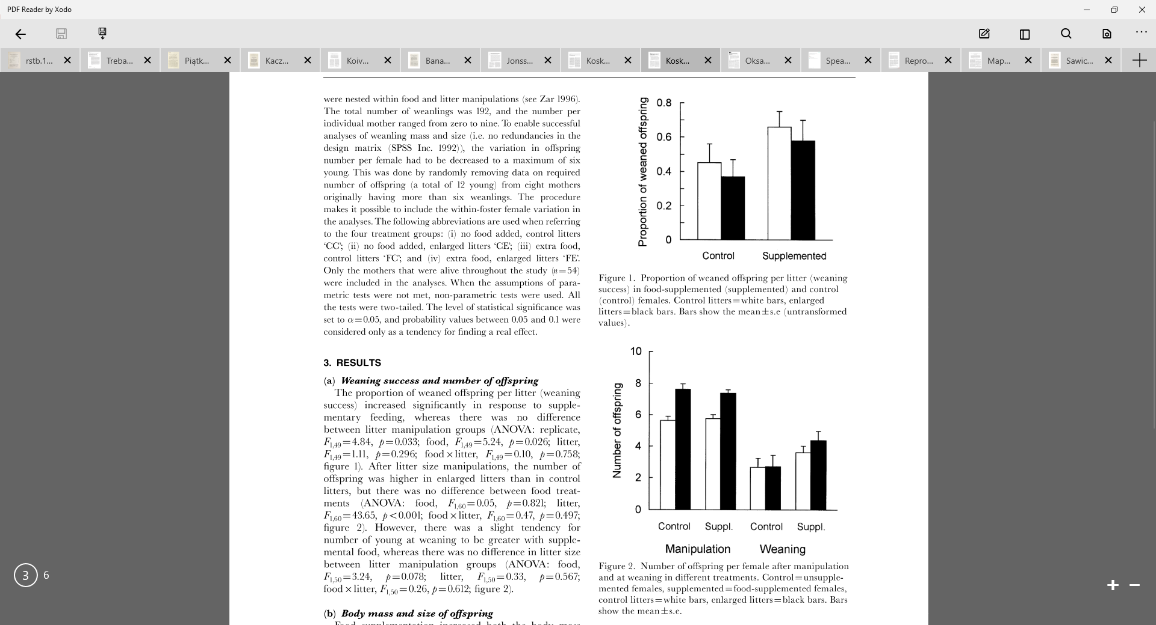
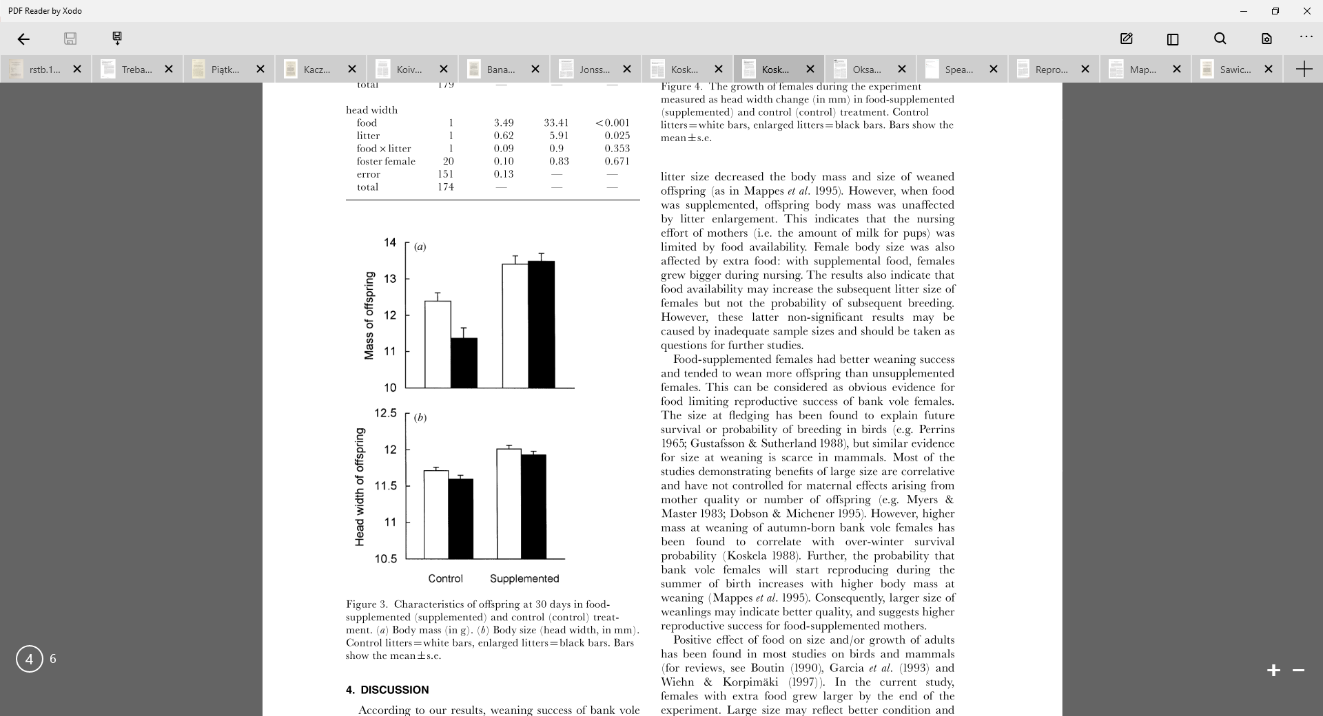
Lactation
Other useful patterns
Koskela et al. 1998
– food supplementation

Slide 22
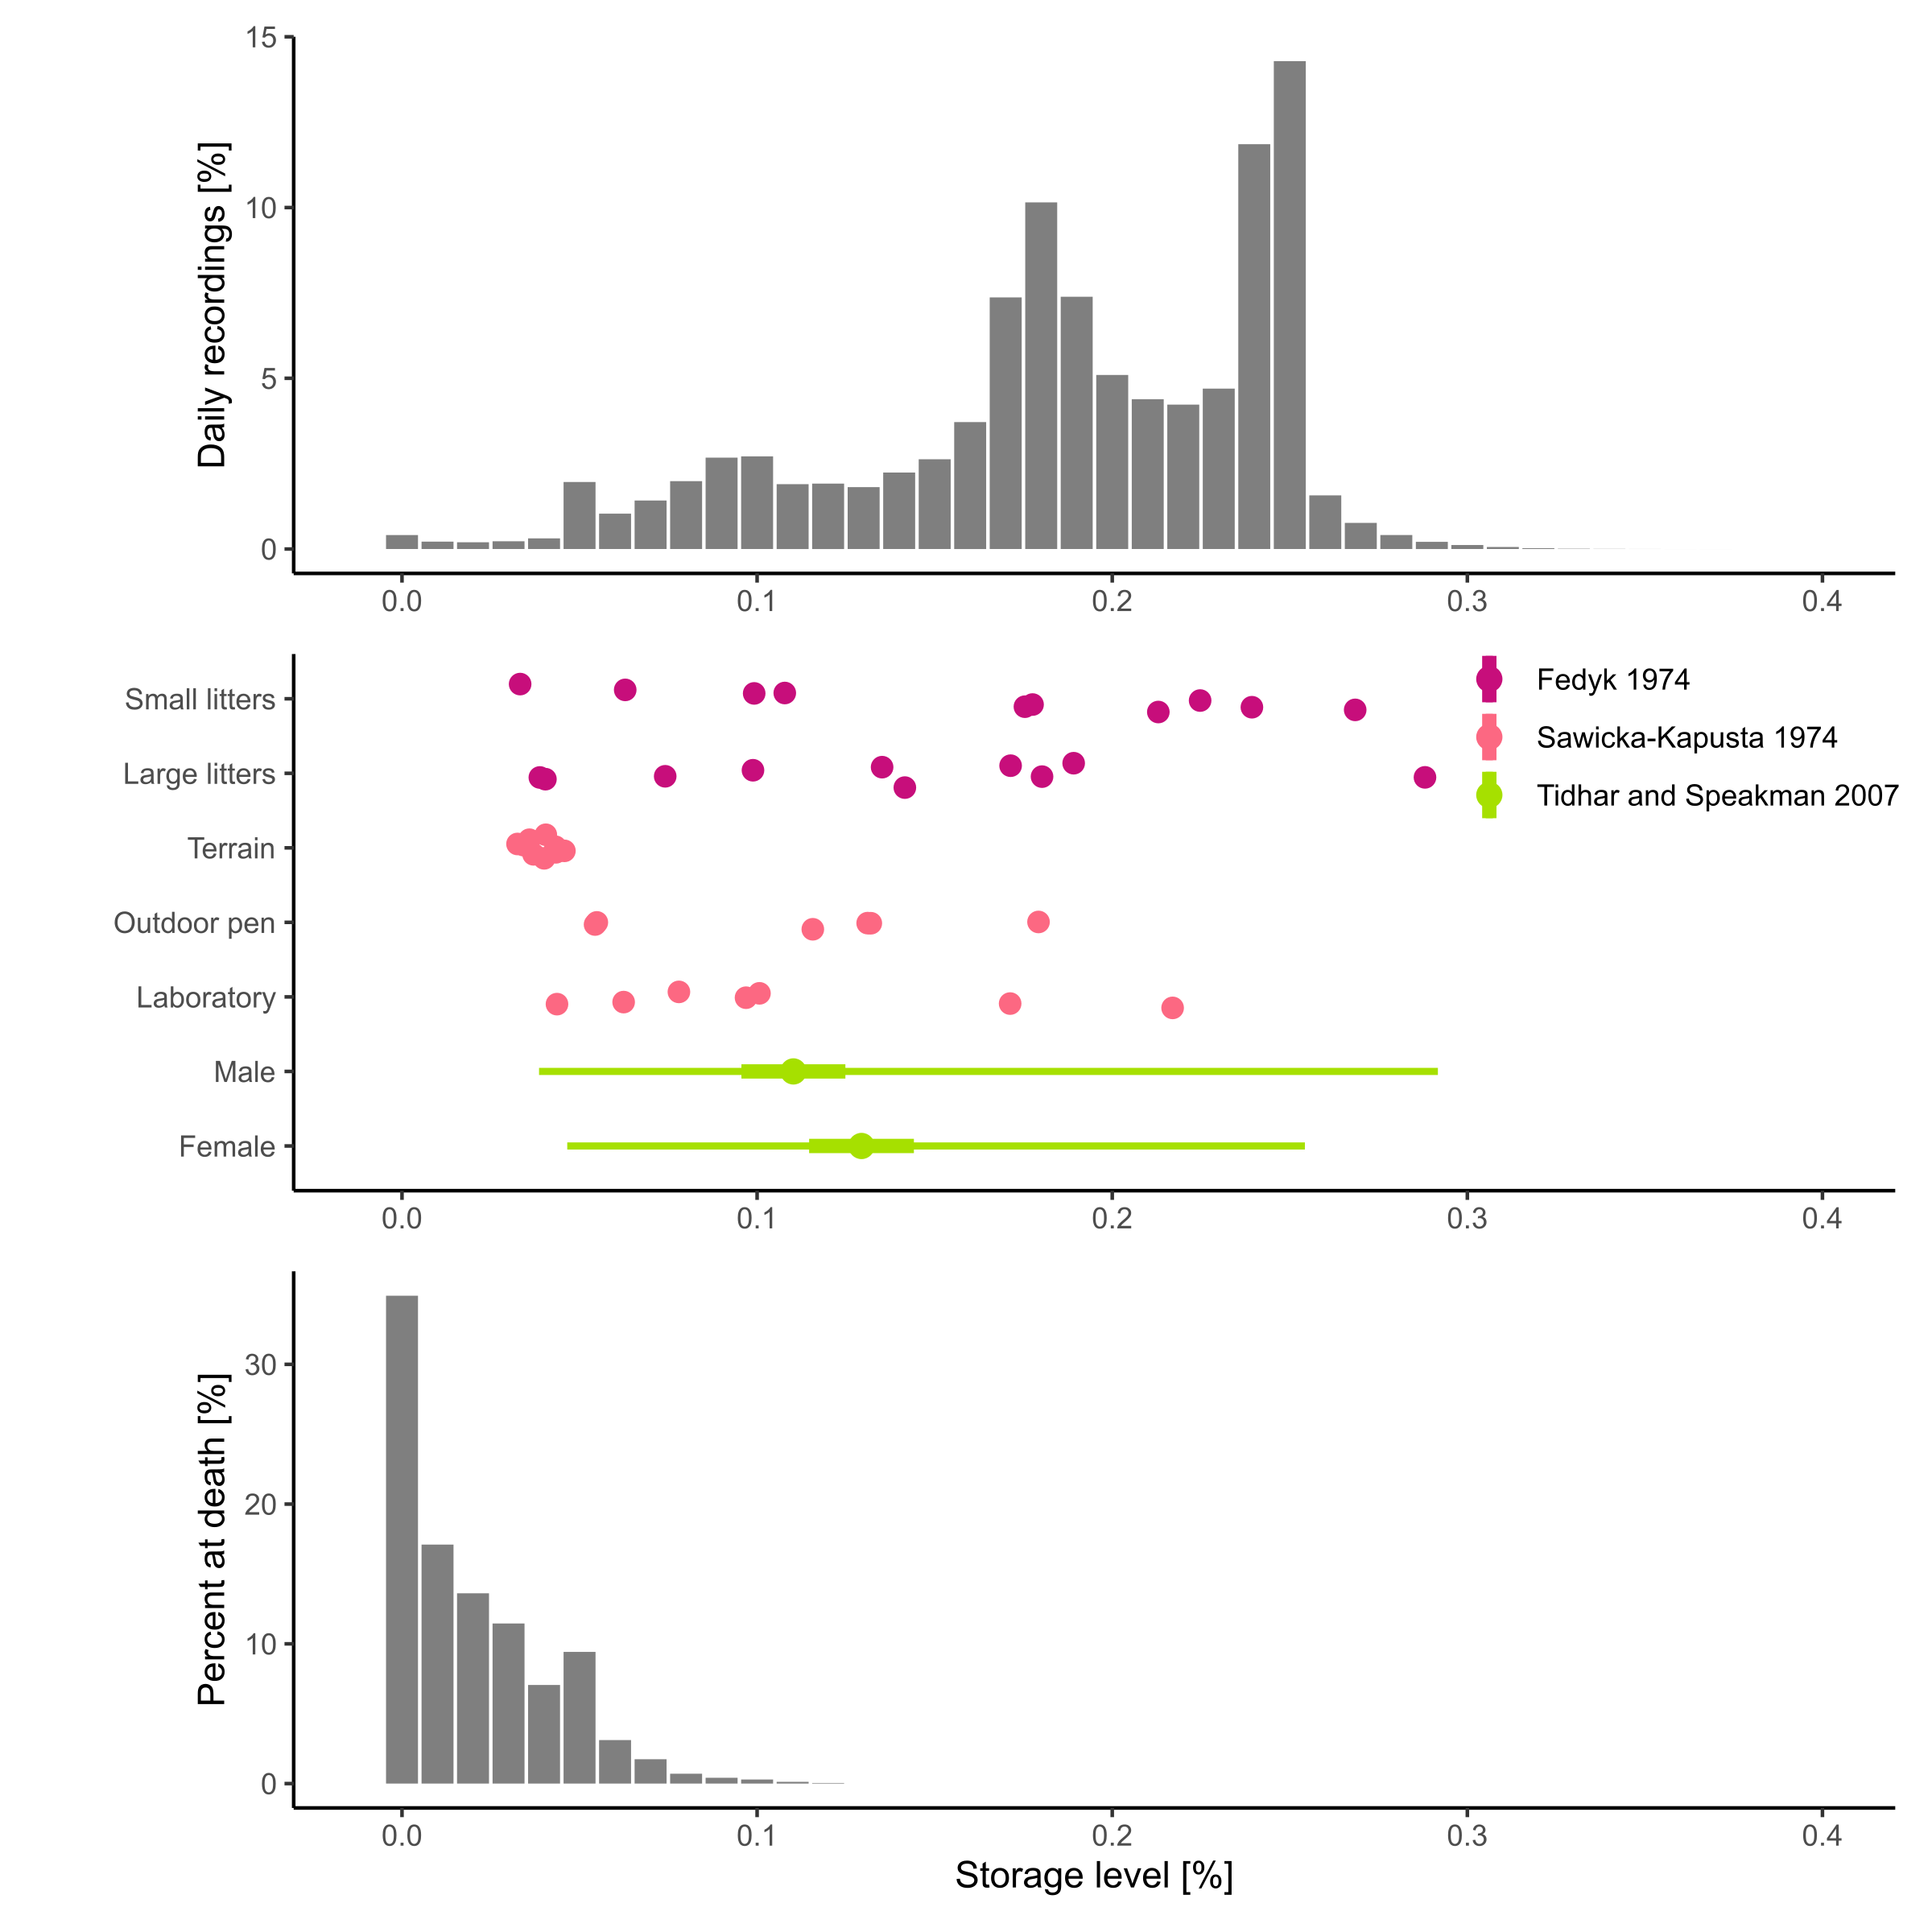
Storage

Slide 23
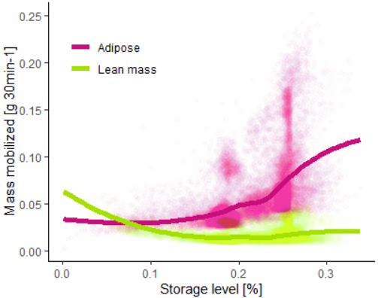
Storage

Slide 24
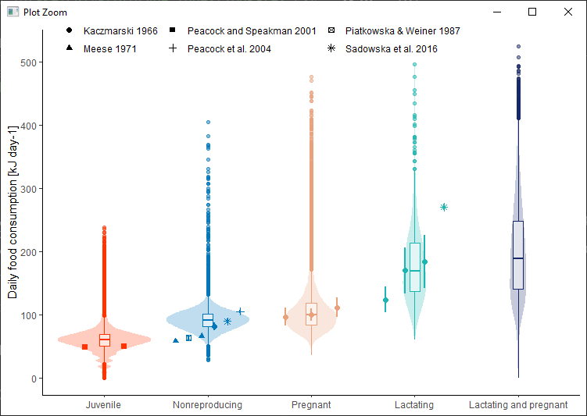
Ingestion rate

Slide 25
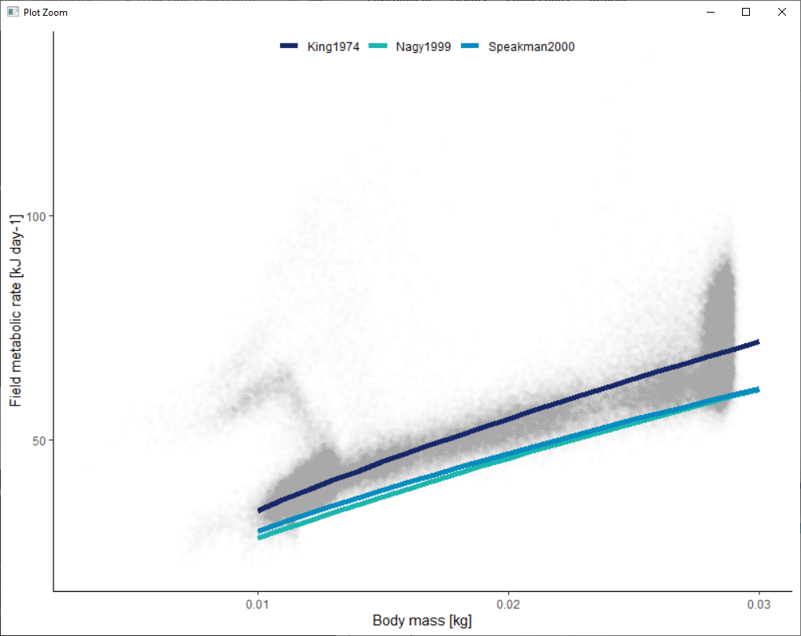
Field metabolic rates
Rodents
Small mammals

Slide 26
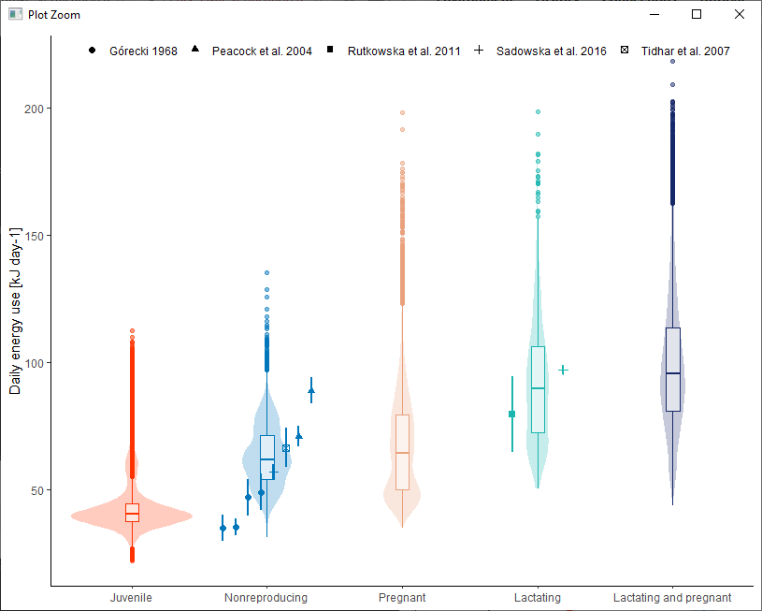
Field metabolic rates

Slide 27
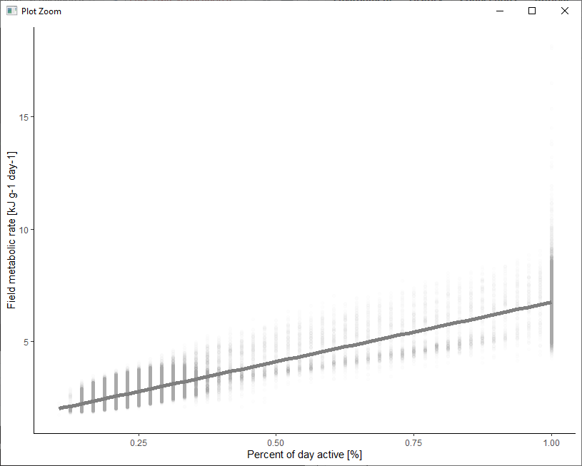
Field metabolic rates

Slide 28
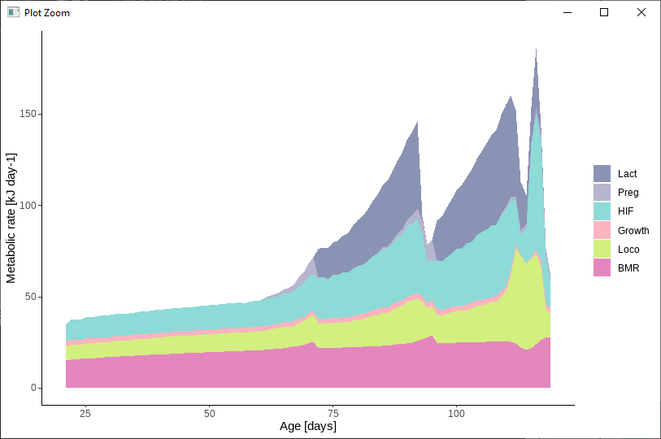
Field metabolic rates

Slide 29

Population level

Slide 30

My vision
How does the environment encourage the evolution of different metabolic phenotypes?
Generic & clear
How does individual variation in metabolic traits affect population dynamics and disturbance vulnerability?
Thoroughly evaluated
How do energy management strategies impact population dynamics and disturbance vulnerability?
Novel
EB model

Slide 31
Energy budget verification summary
Overall many fits good, others give us something to think about
For now allocation and survival probabilities are arbitrarily selected – should be calibrated
Need population level patterns – e.g. cycles, densities, age-class structure
Need to think about:
Whether maximum metabolic rates should be included
Link between EB and pace of life
Where to add individual variation
Whether BMR depression with negative energy balance should be included in this step

Slide 32
Full model current status
All animals are female
Wintertime skipping isn’t implemented
Movements are still basic
Landscape also still very basic ( patch size )

Slide 33
Next steps
Arrange a meeting with Jana, Melanie, etc.?
Implement environment specs & movements
Calibrate & evaluate
Publication plan – model paper or go right into first big question?

Slide 34
Notes from Florian
Change “Percent of day active” to “Percent of timesteps with activity”
Big things to look into:
How offspring mass relates to litter size – look into allocation and mortality
100% activity realistic?
Record storage level based on state

